Slide 1


Preparation of monthly rainfall maps based on interpolation techniques using location-based and hybrid approaches
Urmia & Brizben

Slide 2



LAYA ZEINALI Ph.D candidate of forest ecology at Tarbiat Modares university, Tehran, Iran interested in the environment and the planet and climate change issues, cooperation in vaious environmental project

Slide 3


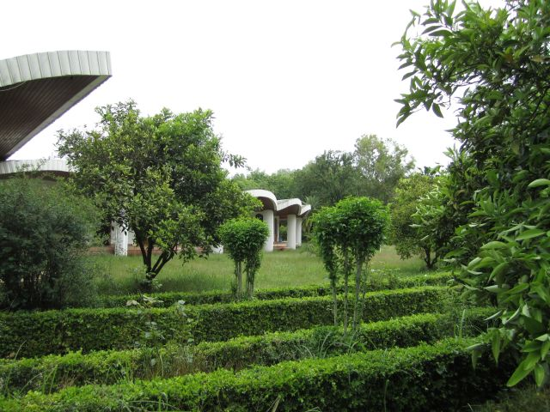
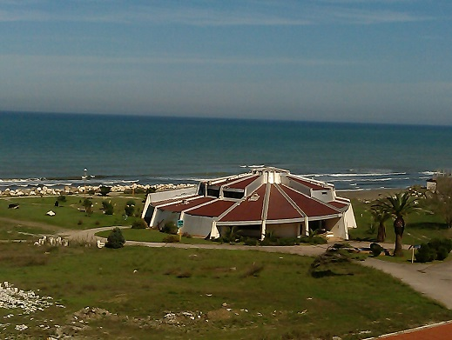

Tarbiat Modares university, N.R. faculty

Slide 4

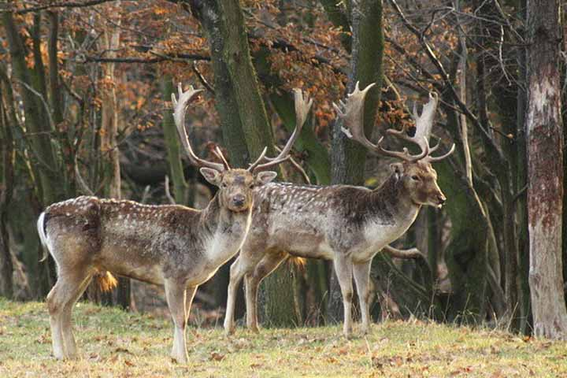
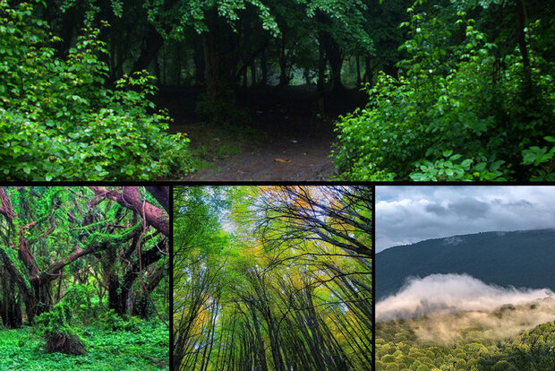
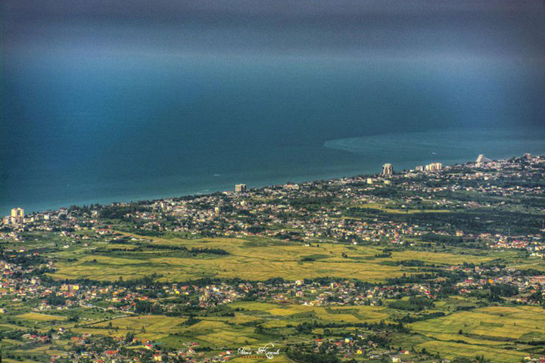

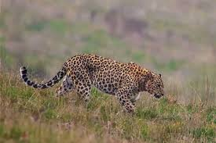
Hyrcanian forests

Slide 5
We prepare monthly rainfall maps based on interpolation techniques (IDW) using location-based and hybrid approaches in the three northern provinces of Iran. As check the normality of the data, we draw the plot of the maps.
Using packages
Rcmdr
automap
sp
Gstat
raster

Slide 6
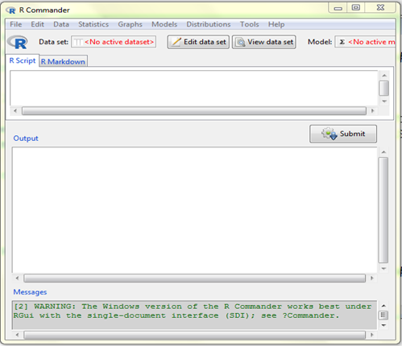
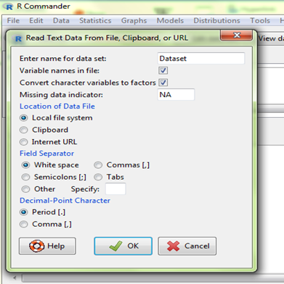
We use Rcmdr package for input data A platform- independent basic-statistics for R. As we run this command library (Rcmdr) open this window

Slide 7
Automap
automatic interpolation package
Sp
classes and method for spatial data
Gstat
geographic data analysis and modeling
Raster
spatial and spatio-temporal geostatistical modelling, prediction and simulation

Slide 8
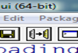
We use all commands from R-editor with run line or selection
Data control with these commands used to manage the R workspace
Str (Data)
Tail (Data)
dim(Data)
summary(Data)
Head (Data)
names(Data)

Slide 9
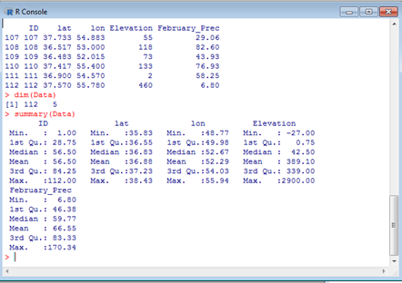
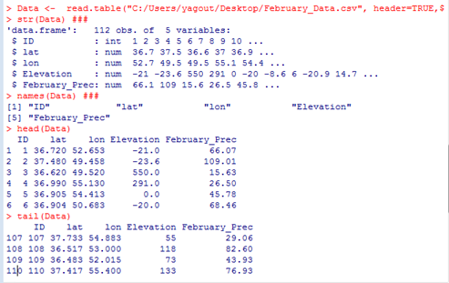

Slide 10
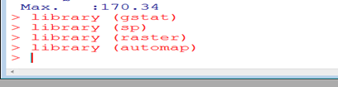
Therefore input data and loading packages, we start statistical analysis
Then we want IDW output, primarily check data normality with these codes
To normalize data, one of the following 3 codes is executed
Hist (Data$ February_Prec)
Boxplot (Data$ February_Prec)
shapiro.test(Data$February_Prec)

Slide 11
Null hypothesis: Assumption H0: The data distribution follows the normal distribution. If the p-value is less than 0.05, it means that your H0 hypothesis is rejected. If it is rejected, it indicates that the data distribution does not follow the normal distribution. If the p-value is greater than 0.05, then the data distribution follows the normal distribution. >
p-value = 0.01014
Data$February_Prec.Log <- log(Data $February_Prec)
Data$February_Prec.Log10 <- log10(Data $February_Prec)
Data$February_Prec.SQRT <- sqrt (Data $February_Prec)

Slide 12
We use shapiro.test command to control again
p-value = 0.9359
Now run the following command
Data$February_Prec.Trans <- Data$February_Prec.SQRT
Convert data to spatial data
coordinates(Data) <- ~ lon + lat ### ~ X+Y
Here our X was lon and our Y was lat (according to the input data)

Slide 13
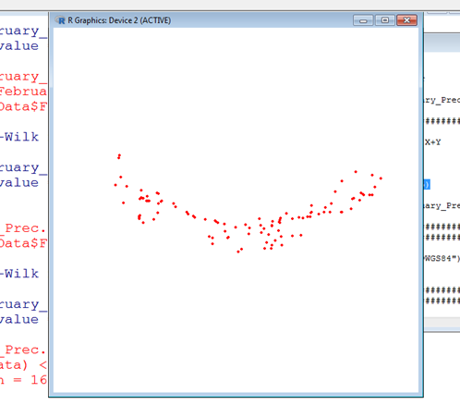
"SpatialPointsDataFrame" After converting, we plot.
plot(Data, pch = 16, col="red", cex=0.5)

Slide 14
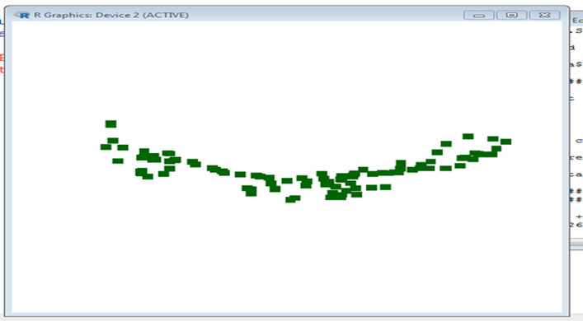
Draw the same plot above by changing the command again
plot(Data, pch = 15, col="darkgreen", cex=1.5)

Slide 15
Now we define the coordinate system for our data. The coordinate system is determined using crs (). Because the coordinate system is latitude and longitude, the following two codes can be used.
crs(Data) <- CRS("+proj= longlat +datum=WGS84")
crs(Data) <- CRS("+init=epsg:4326")
Now we load the provinces. The system package itself calls the data. If we do not know the file path, run it with the choose.files () command and select our file from the opened window. I used a shapefile in this exercise. The following commands are different for each system.

Slide 16
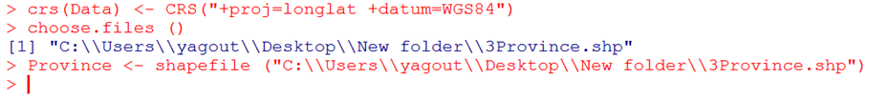
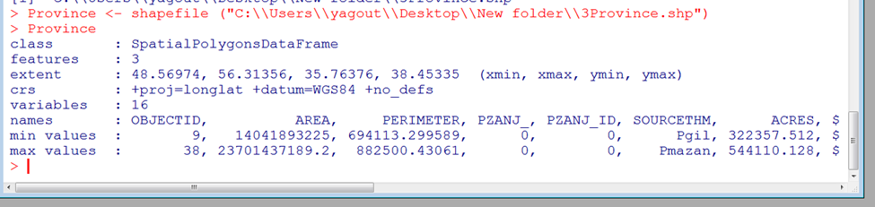
Province <- shapefile ("E:\\Dropbox\\3Province\\3Province.shp")
Province <- shapefile ("E:\\Mega Cloud Storage Yahoo Account\\3Province\\3Province.shp")
Province <- shapefile ("D:\\Mega Cloud Yahoo\\3Province\\3Province.shp")

Slide 17
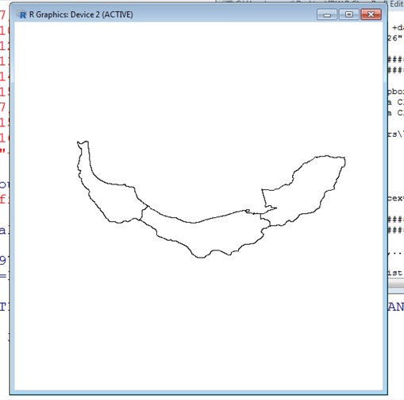
Execute plot (Province): Map of provinces is plotted.

Slide 18
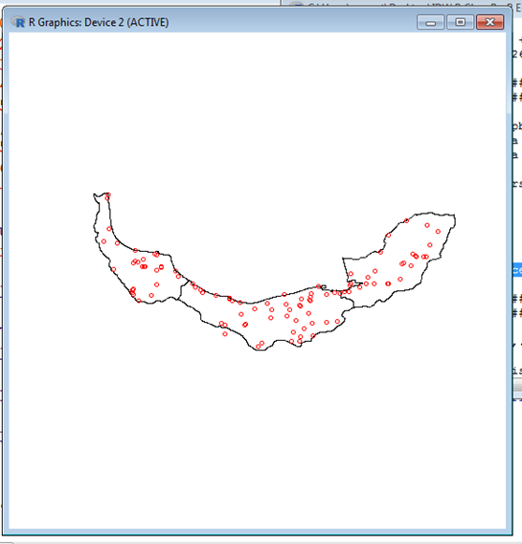
Using the points command (Data, pch = 1, col = 'red', cex = 0.7) we also bring the points, the important point here is that if we run the points first, it gives an error, we must first plot And then run points. It is as shown below.

Slide 19
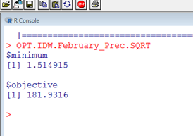
IDW is a non-geostatistical interpolation technique that works based on distance, giving more weight to nearby points to more distant points and a power to invert the weight distance. This power is very important. What you can choose. Execute in order using the following commands.
f = function(idp, formula, data,...)
sum(krige.cv(formula,data,set=list(debug=0,idp=idp),...)$residual**2)
OPT.IDW.February_Prec.SQRT <- optimize(f, interval=c(0.01,5), formula= February_Prec.SQRT ~1, data=Data)
OPT.IDW.February_Prec.SQRT
Power Results: 1.514915 causes the lowest error rate.

Slide 20
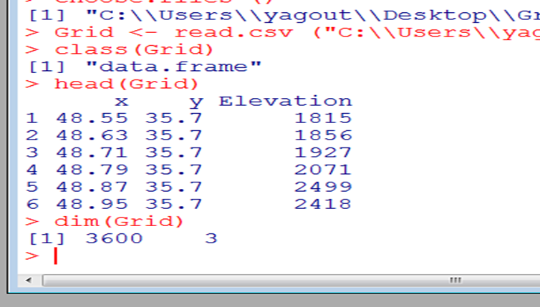
Now we need to design a network using the following command:
Grid <- read.csv ("C:\\Users\\yagout\\Desktop\\Grid.DEM.csv", header=TRUE)
Executing the class (Grid), head (Grid), and dim (Grid) commands executes the type here dataframe and the head and dim commands described above, respectively. As shown below:

Slide 21
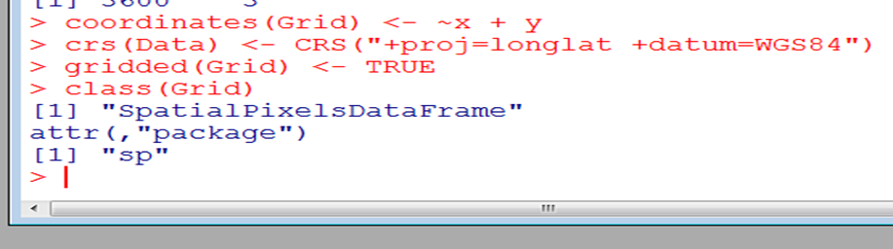
We have three columns: X, Y, Elevation. And in the image above, we see that the data is a dataframe, so we convert it to spatial data again. With this command we define: coordinates (Grid) <- ~ x + y and the coordinate system.
crs(Data) <- CRS("+proj=longlat +datum=WGS84")
gridded(Grid) <- TRUE
class(Grid)

Slide 22
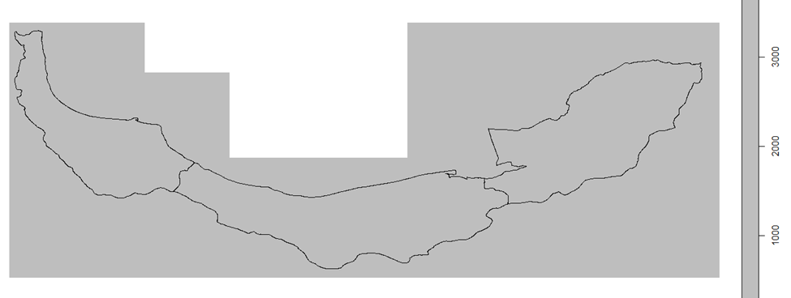
Then, by executing the plot command (Province, add = T), we bring the masters map on the network. In this picture, the grids are very, very close to each other, so we have to reduce the size from 0.08 (about one kilometer).
Grid <- expand.grid(x=seq(from=48.55, to=56.5, by=o.o8)

Slide 23
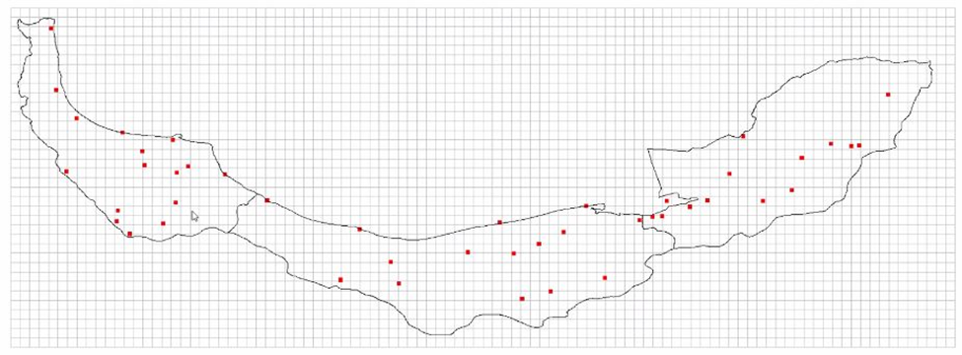
IDW codes:
IDW.February_Prec.SQRT <- gstat::idw(February_Prec.SQRT ~ 1, Data, newdata = Grid, idp=1.514915)

Slide 24
In the idp section, we place the optimal power.
names(IDW.February_Prec.Trans)
summary(IDW.February_Prec.Trans)
head(IDW.February_Prec.Trans)
class(IDW.February_Prec.Trans)
gridded(IDW.February_Prec.Trans) <- TRUE

Slide 25
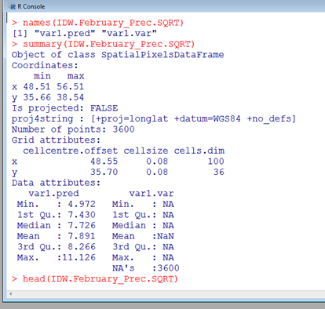
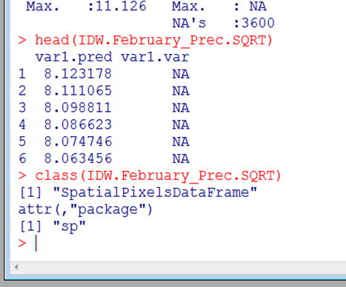
we draw grid, again: gridded( IDW.February_Prec.SQRT) <- TRUE

Slide 26
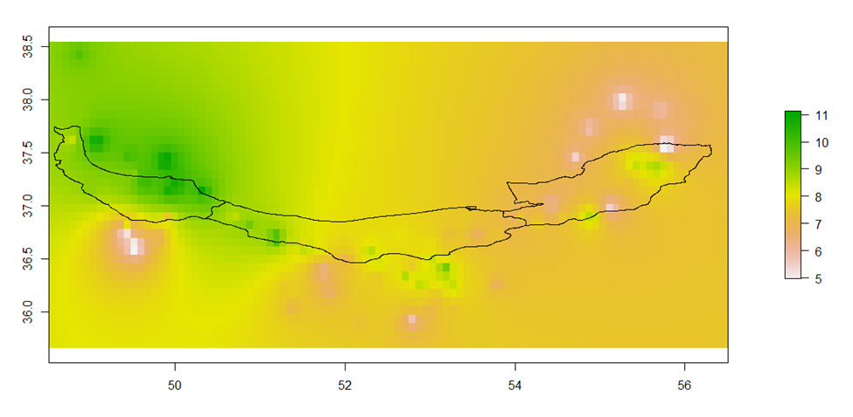
And execute the following commands in order:
IDW_February_Prec.SQRT.Pred <- raster(IDW.February_Prec.SQRT[,1])
IDW_February_Prec.SQRT.Pred
plot(IDW_February_Prec.SQRT.Pred)
plot(Province, add=T)

Slide 27
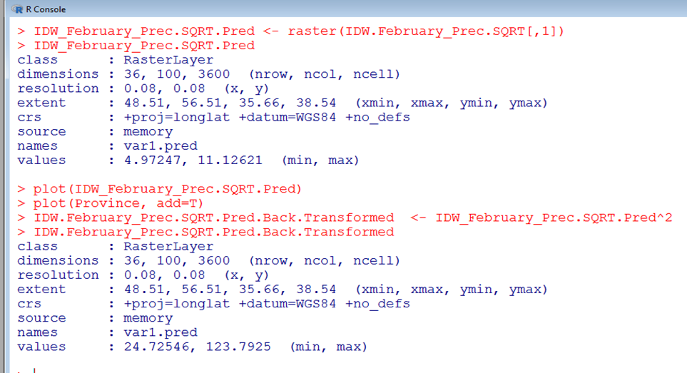
According to the picture above, the amount of rainfall is more in the west of Hyrcanus and gradually decreases to the east. The green parts have maximum precipitation. There is minimal rainfall in Golestan province, except for the small spots shown in the picture.We need to convert this converted data back to the original data. Returns data to exponent 2.
IDW.February_Prec.SQRT.Pred.Back.Transformed <- IDW_February_Prec.SQRT.Pred^2
IDW.February_Prec.SQRT.Pred.Back.Transformed

Slide 28
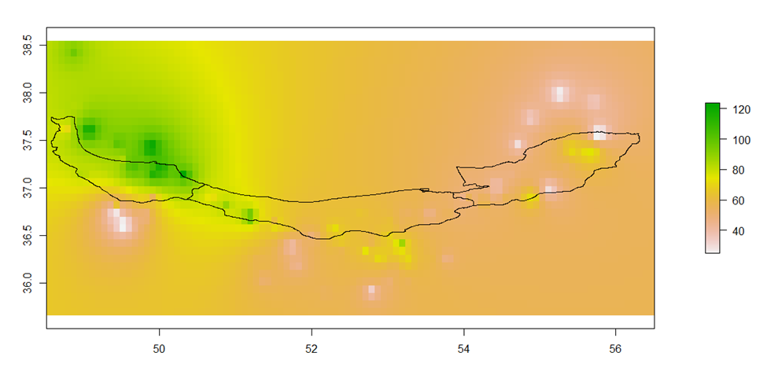
For transformed data:

Slide 29
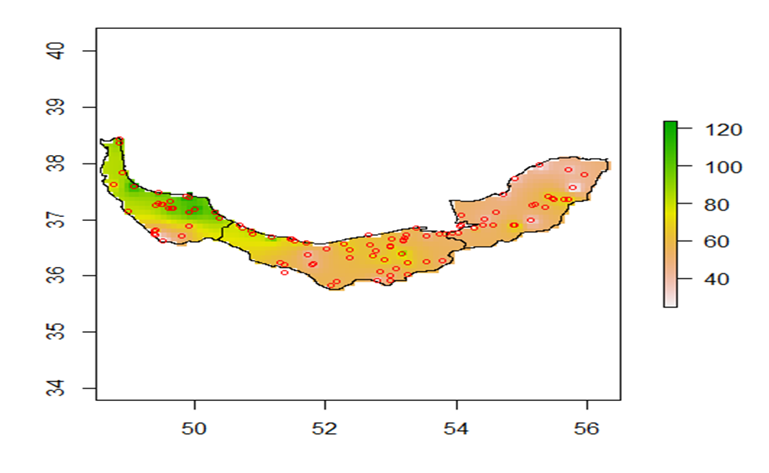
Now we will mask our map according to the northern area. Using the following commands
IDW.February_Prec.SQRT.Pred.Masked.Back.Transformed <-mask(IDW.February_Prec.SQRT.Pred.Back.Transformed, Province)
Plot (IDW.February_Prec.SQRT.Pred.Masked.Back.Transformed )
plot(Province, add=T)
points(Data, pch=1, col='red', cex=0.7)

Slide 30
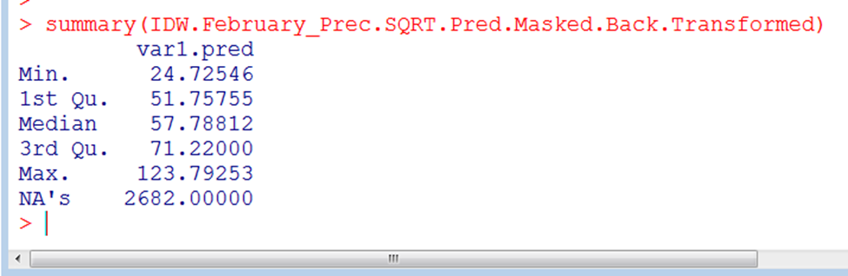
Now, with the following command, we get a summary of the amount of rainfall.
summary(IDW.February_Prec.SQRT.Pred.Masked.Back.Transformed)
Execute the following command. With the getwd () command, we got the file path where it was saved.
writeRaster(IDW.February_Prec.SQRT.Pred.Masked.Back.Transformed, filename="IDW.February_Prec.SQRT.Pred.Masked.Back.Transformed.tif", format="GTiff", overwrite=TRUE)
The final analysis plan in Qgis software for February is as follows.

Slide 31
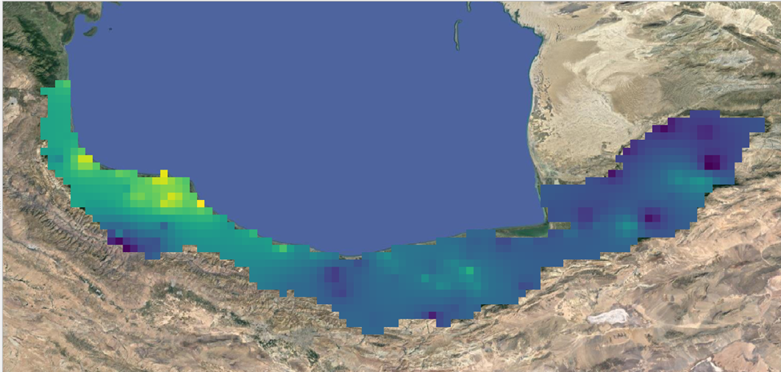
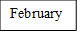

Slide 32
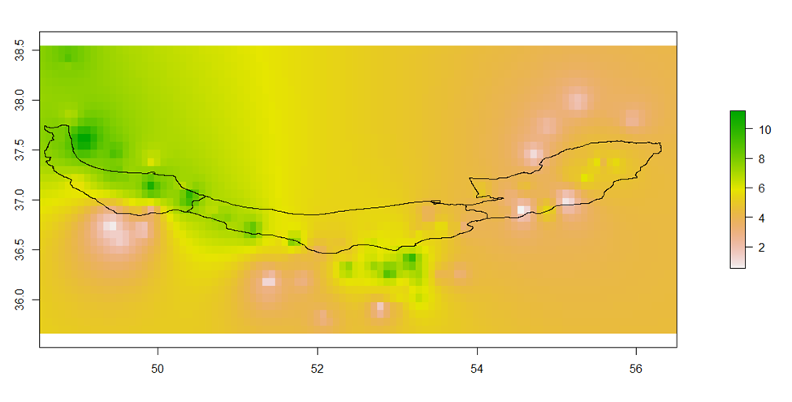
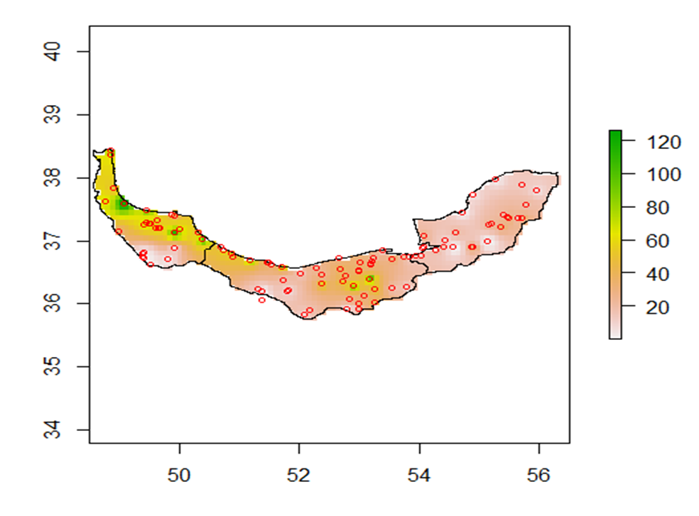
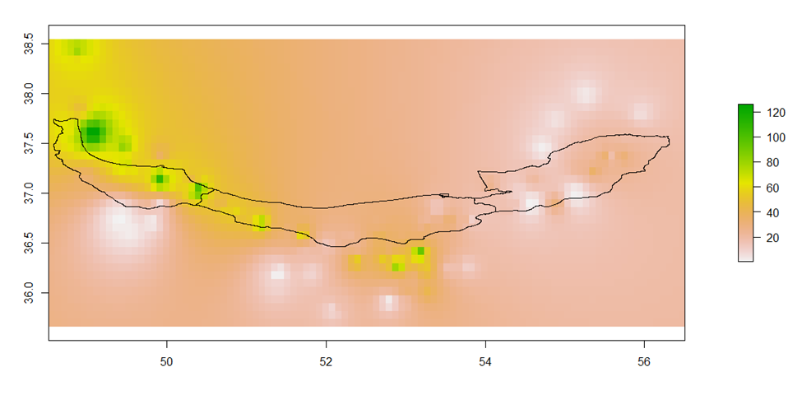
We will do all the above steps again for the August data.
According to the results for August, the amount of rainfall is higher in the western region, darker color indicate more rainfall.
August

Slide 33
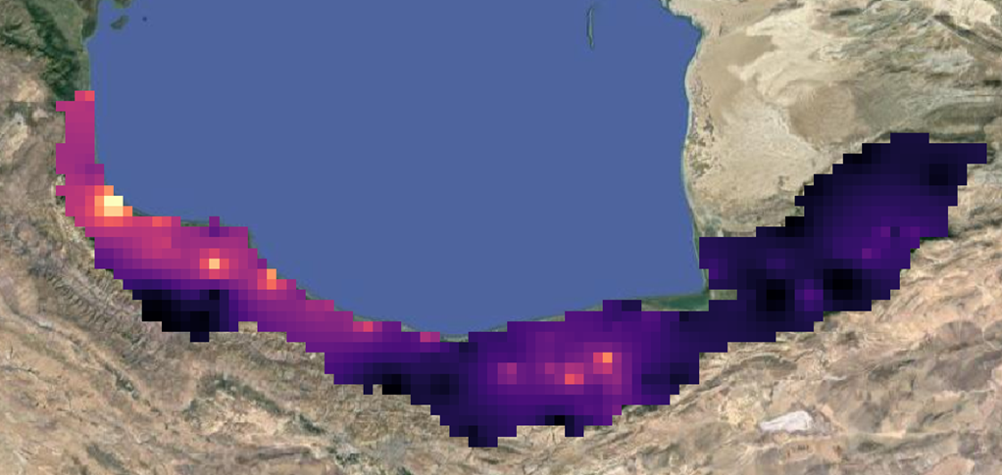
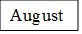

Slide 34
Analysis of two maps: February and August showed that the amount of rainfall in February is higher due to the rainy season and the constant temperature and angle of the sun, resulting in less evapotranspiration. But in August the temperature is higher and evaporation is higher and the amount of precipitation is less. According to the obtained amount, precipitation in February is less than from August. Also, according to the maps, you can see the difference between these two months. In general, there is more rainfall in the west of Hyrcanus than in the east. In some places, due to the lack of meteorological stations, accurate information about those places is not available and it is usually associated with errors in these places.
Result

Slide 35
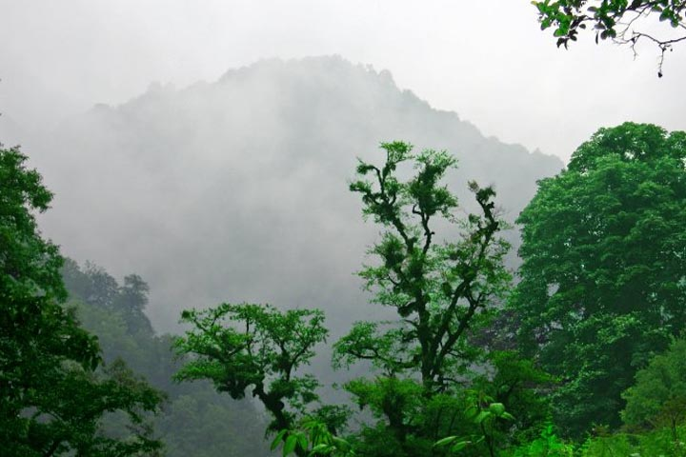
With kind regards
Q & A
Contact me:
Email: zeinaliyadegarilaya@modares.ac.ir
Twitter: laya_zeinali
Instagram: laya_zeinali
Linkedln: layazeinali

